Slide 1
Capstone Project - 1
Global Terrorism Analysis
Team Members Jayanth V Gowthaam Kumarasamy

Slide 2

Prerequisites Followed For This Analysis
1. Defining the problem statement
2. Importing necessary libraries
3. Descriptive statistics summary
4. Data cleaning(Null value treatment, dropping columns, etc.)
5. Graphical portrayal

Slide 3



Global Terrorism
Terrorism is generally defined as using indiscriminate violence to incite fear or terror in the heart of people in order to achieve religious, financial, ideological, or political goals. In recent years, terrorism has spread its tentacles globally and is the favorite method of fanatics to gain what they desire. Terrorism is a major problem all over the world at the moment. It affects a country’s economy and we make an analysis on the basis of this, from the dataset that we got from the Study of Terrorism and Responses to Terrorism (START). This dataset consists of the attacks that took place from the year 1970 to 2017.

Slide 4
Points for Discussion
1. Terrorist attacks each year.
2. Terrorist groups with the most number of attacks.
3. Top countries with the most number of attacks.
4. Number of casualties in a region and also in a country.
5. Deaths and damages that take place each year.
6. Weapons used to carry out attacks.
7. Most frequent target areas.
8. Region and city-wise terrorist attacks
9. Suicides that happened during the terrorist attacks.
10. Successful attacks by the terrorists

Slide 5
Data Analysis Steps
Importing necessary libraries :
To carry out our analysis we have imported the necessary libraries like pandas, NumPy, seaborn, and matplotlib.
Descriptive statistics summary :
In this part, we start by looking at descriptive statistic parameters for the dataset. We will use describe() for this.
Data cleaning(Null value treatment, dropping columns, etc.) :
Further, we get to clean the data by dropping unnecessary columns and columns that have the most number of NAN values.
The graphical portrayal of our data frame:
In the journey of our analysis, we tend to graphically represent our analyzed data frame put under various circumstances.

Slide 6
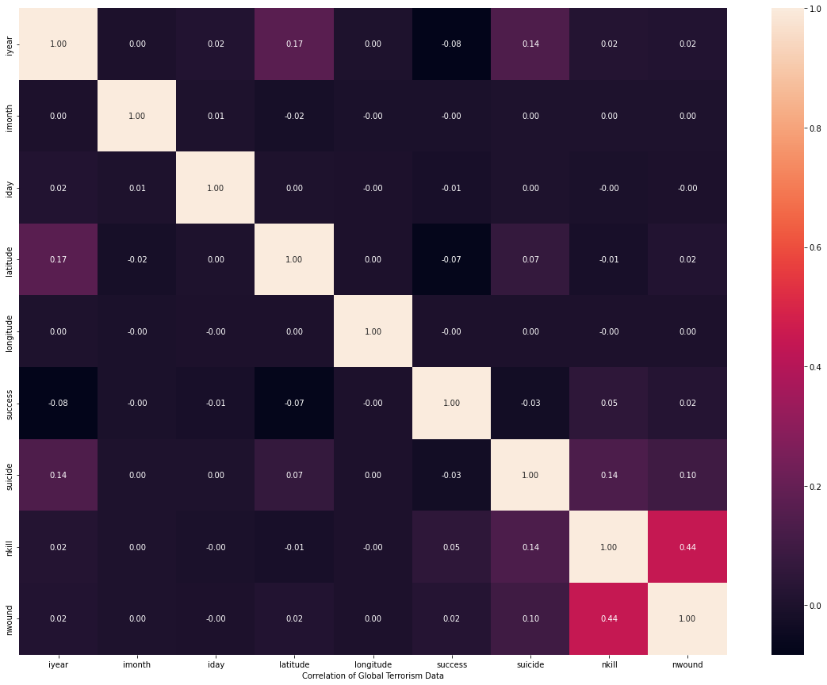
Generating Heat Map for the correlated data
1. After cleaning our dataset we then perform correlations between the columns just to get an insight into whether the values between two columns are negatively correlated to each other or not.
2. From this heatmap displayed we get to know the
Correlation of the values between columns. Some
of them have a negative correlation and some don’t
3. The colours indicate the intensity of the variation

Slide 7
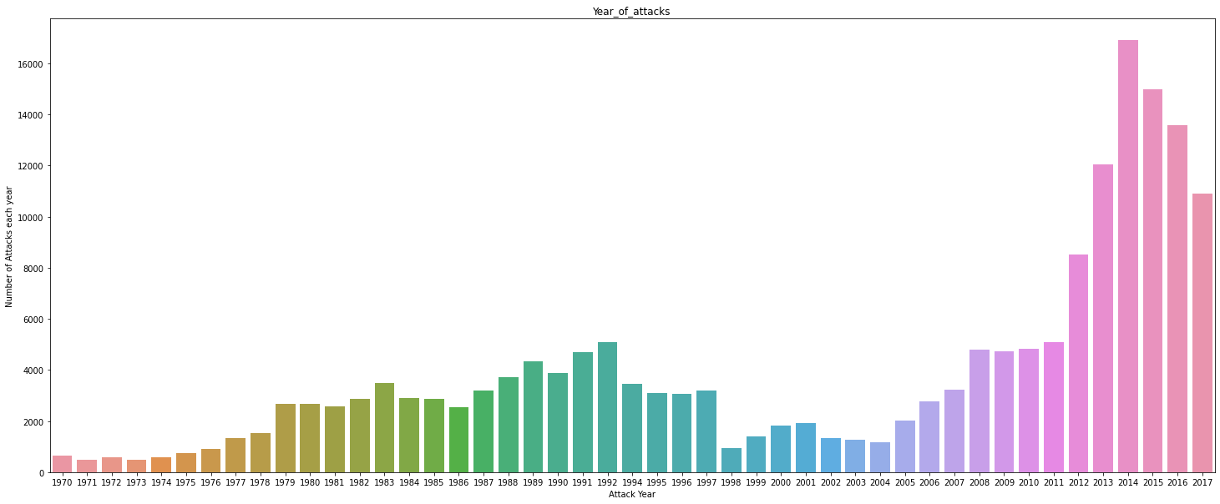
Most Number of attacks in recent years
1. This bar graph shows the years in
Which the most number of terrorist
Attacks took place.
2. The result is 2014 where more
Number of terrorist acts that took
place and the last one was in the
span of Years 1970 to 2000.

Slide 8
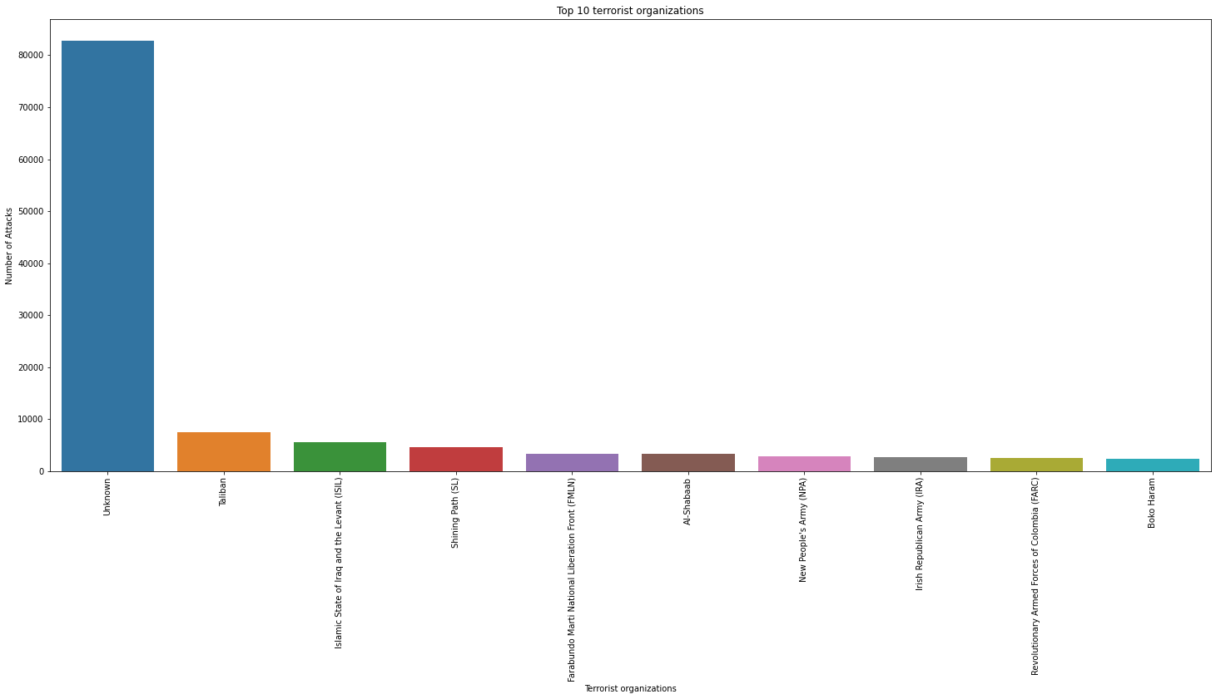
Organizations responsible to carry out these attacks
1. In this bar graph we tend to Conclude that the TALIBAN were responsible for carrying out the most numbers of attacks throughout the years.
2. The peak value in the graph are the groups that are not recorded
3. Over 7478 attacks took place over the
Years in which the Taliban was the
reason Behind it.
4. The least attacks were made
By the organization named
BOKO-HARAM.

Slide 9
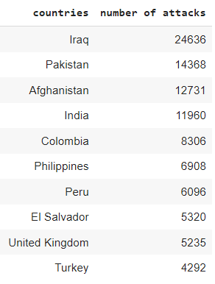
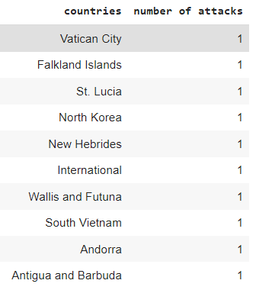
Countries with most attacks
1. This is the table that has the country’s name listed and
The corresponding number of attacks took place in them.
2. We concluded that “IRAQ” is first place in the top
20 most terrorist attacked country.
3. number of attacks from 1970 to 2017 in IRAQ
were 24,636.
4. Minimum number of terrorist attacks happened in
Antigua and Barbuda.

Slide 10
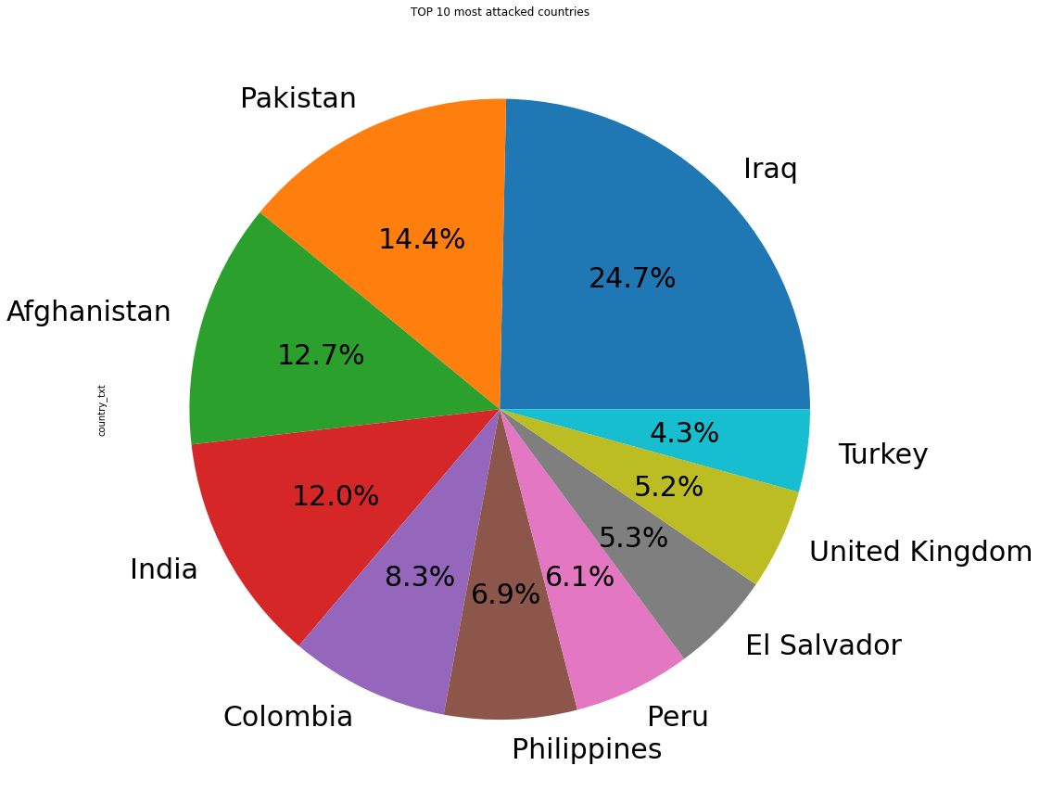
Countries with the percentage of attacks
1. This pie chart was derived from the analysis made of the countries that have the most number of terrorist attacks.
2. IRAQ has the highest number of terrorist attacks compared
To the rest of the world which has around 24.7%
3. Considering this pie chart, the least no of terror attacks
Took Place in turkey since we are comparing only the
top 10 countries.
4. Surprisingly India is also on the list of the top 5
Countries with around 12.0%

Slide 11
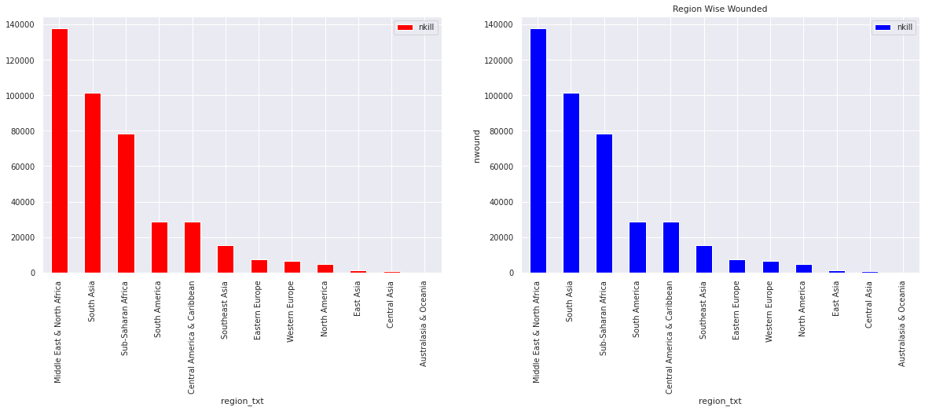
Deaths and Wounded in targeted regions
1. From this bar graph we
Concluded that the most number
Of deaths took place in the Middle
East & North African region,
The number is around 1,37,642.
2. Considering the wounded it
Goes up to 2,14,308 in this region

Slide 12
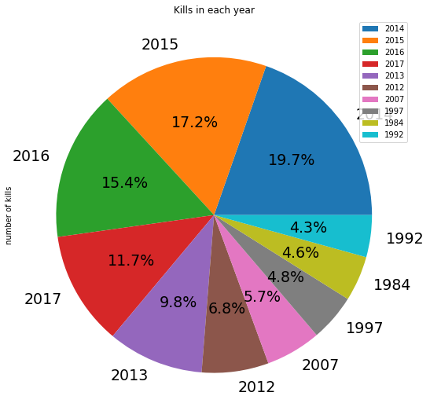
Percentages of deaths taking place each year
1. This is the pie chart that has the percentage of killings that happen each year and it’s
In the year 2014 where the number of killings got high i.e. up to 19.7%.
2. The least one is in the year 1992 with 4.3%.
3. This clearly shows the drastic increase in the attacks as well as
The intensity of them through the kill rates.
4. In the years after 2014 that we could see that the
Percentage goes quite low i.e. in the year 2015
only 17.2% of casualties were reported and consecutive
years after that the killing rate has got down
significantly and so do the attacks.

Slide 13
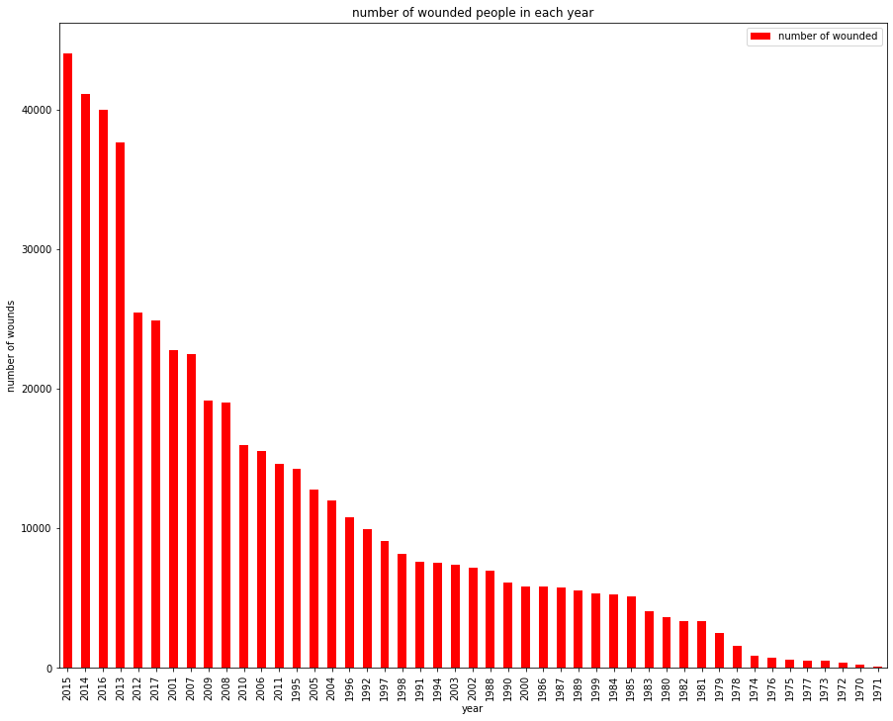
People wounded in terrorist attacks
1. This is the bar graph showing the
people who got wounded year-wise.
and it is in the year 2015, most people
got wounded during attacks.
2. Almost 44,043 people were
wounded in 2015.
3. Comparing this with the least,
1971 in which only 82 people
wounded.

Slide 14
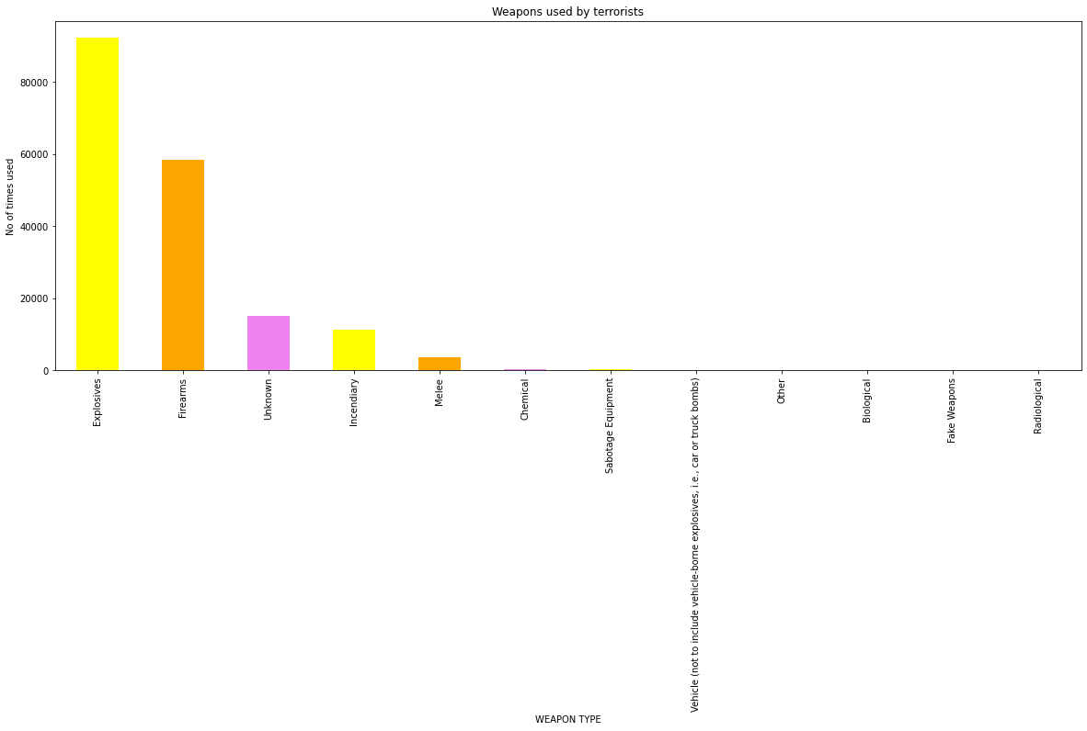
Most common weapons used
1. This is the bar plot which shows
the weapons used by the terrorists
the most to least.
2. Explosives are the most used
weapons by the terrorists which
is about 92426 times.
3. Radiological weapons are the
least used about 14 times.

Slide 15
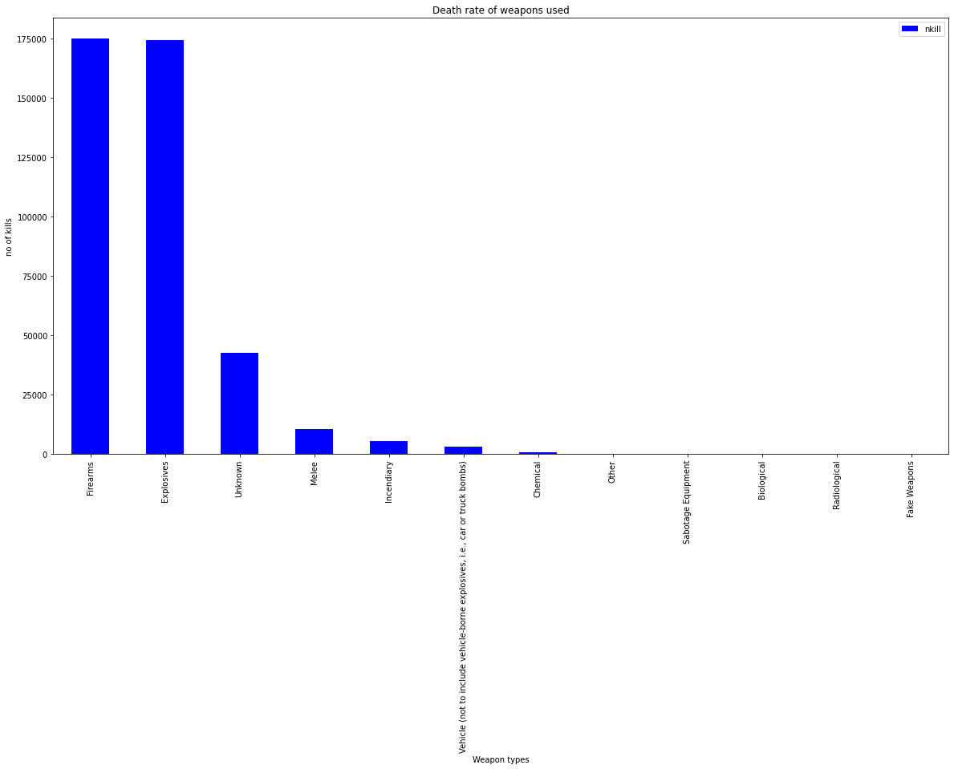
Deaths due to usage of specific weapons
1. This is the bar chart that shows
The death rate for each weapon used.
2. Firearms are the most used
Weapons that lead to death.
174894 people were killed.
3. Fake weapons are the least used
for deaths. Only 1 person was killed
due to this.

Slide 16
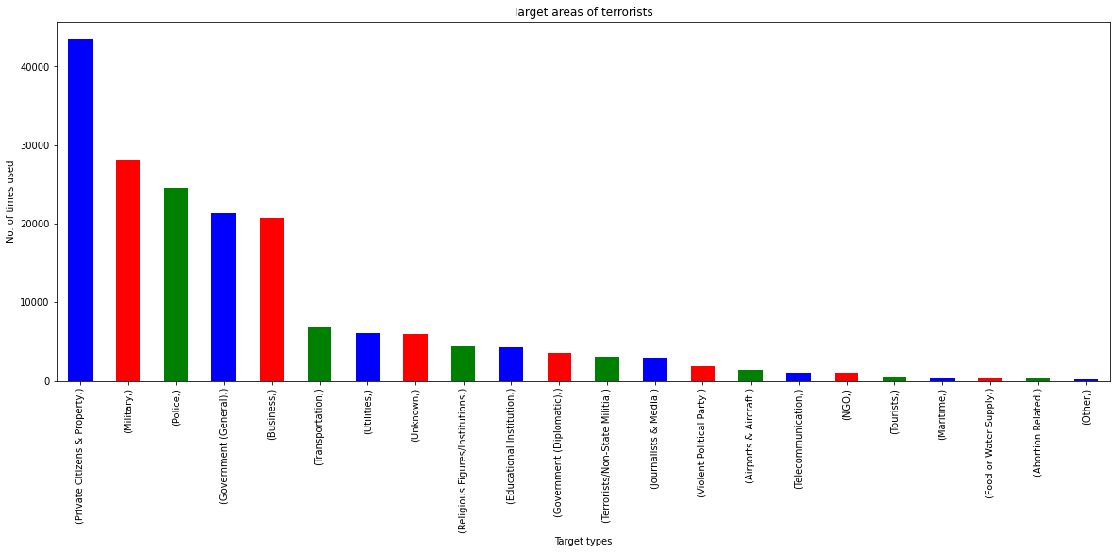
Most common target areas
1. This is the bar plot which
Displays the target areas by the
terrorists during this span.
2. Here Private citizens and
property is the most targeted
and attacked for about 43511
times, followed by the military.
3. Others category is the least
targeted about 137 times.

Slide 17
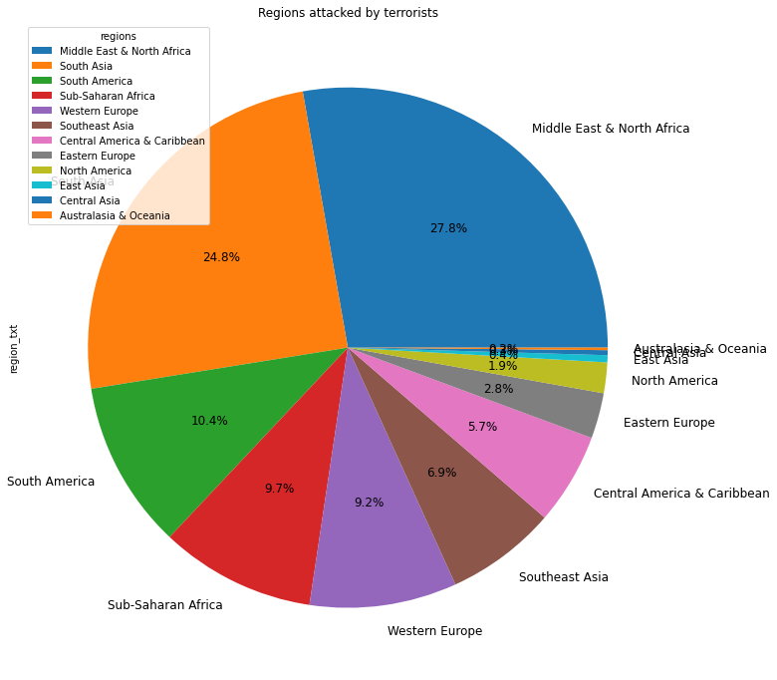
Regions with most terror attacks
1. This pie chart shows the percentage of
regions attacked by terrorists.
2. Middle east & North Africa (27.8%)
is the most attacked region followed by
South Asia (24.8%).
3. Australasia and Oceania is the region
which is the least attacked (0.2%).

Slide 18
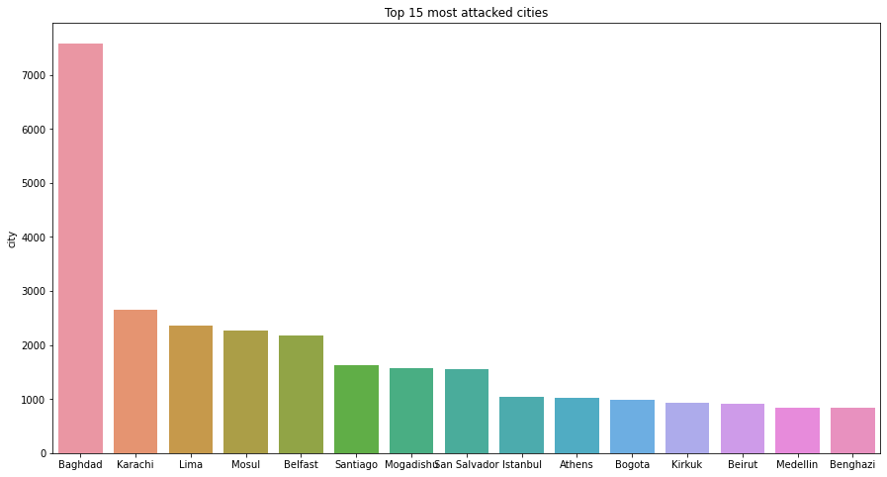
Cities with highest attacks
1. This seaborn bar plot shows the top
15 most attacked cities in the world.
2. Baghdad is the highest attacked city
in the world. It is attacked at about 7589
Times.
3. We can learn that the top cities
Mostly lies in the Middle East and North
Africa region.

Slide 19
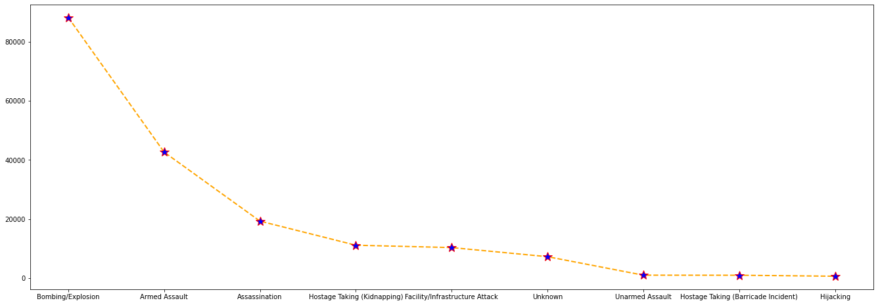
Common attack types carried out
1. This is the line plot that infers
The attacking types of the terrorists.
2. Bombing/Explosion is the type of
attack was mostly executed
by the Terrorists
i.e. 88255 times, followed
by the Armed Assault (42669 times).
3. Hijacking is the least used attack
type which is about 659 times.

Slide 20
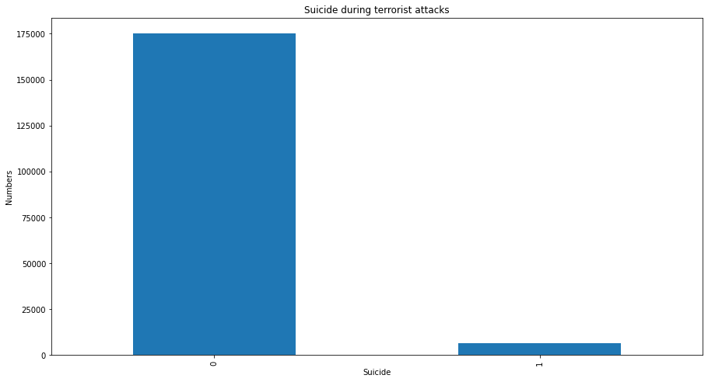
Suicides during terrorist attacks
1. This is the chart that shows the
data about which suicides that
happened during the attacks.
2. It shows only 6633 suicides
held during the terrorist attacks
During the span of 1970 – 2017.

Slide 21
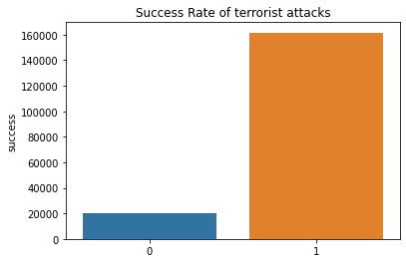
Success rate
1. This is the success rate of the terrorist
Attacks Which planned and executed
successfully.
2. 161632 attacks have been successfully
done which is about 89% success rate of
total attacks involved.
3. 20059 attacks (11%) were failed attacks
by the terrorists.

Slide 22
Overall analysis of the year 2014
The year 2014 attacks (Most number of attacks):
(i). Country: number of attacks is 3933 in “Iraq”
(ii). Regions: number of attacks is 6939 in “The Middle East & North Africa”
(iii). Attack types: 8799 attacks by Bombing /Explosion is the most
(iv). Target types: 4331 attacks on Private Citizens & Property
(v). Weapon type: 9521 Explosives are used
(vi). City: The most attacked city is Baghdad with 898 attacks.
The following charts show the results and inferences of the terrorist attacks held in
2014:
[ ]

Slide 23
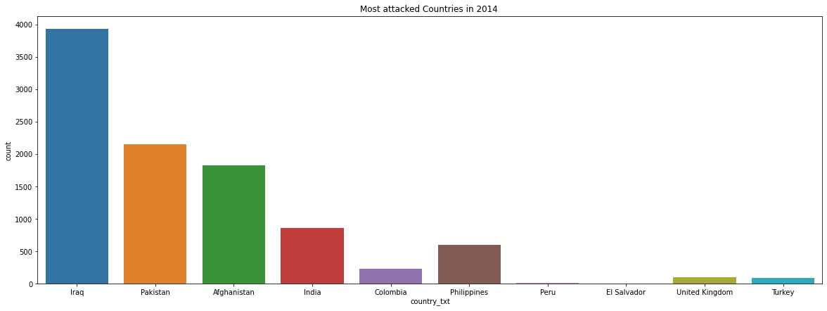
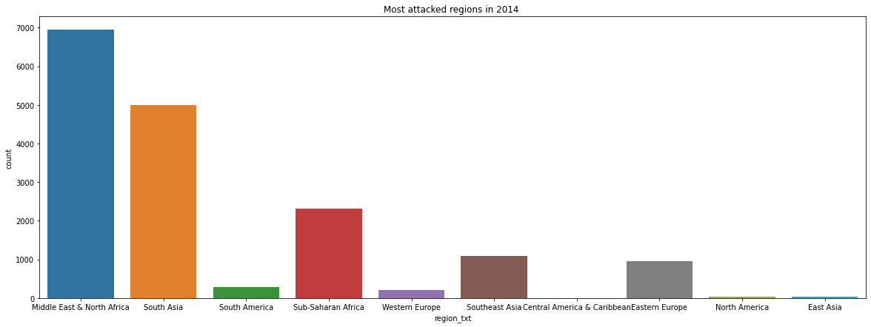
Comparison between countries and regions and their attack rates.

Slide 24
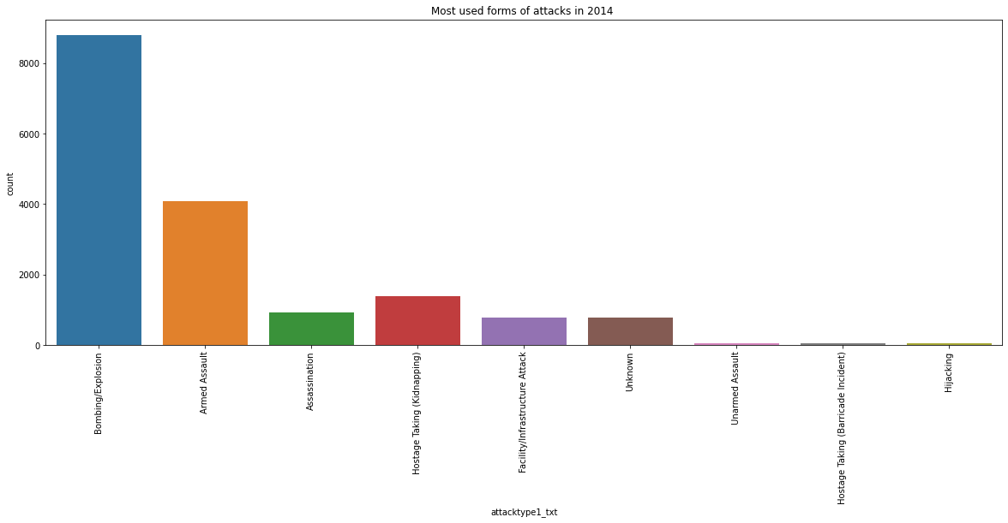
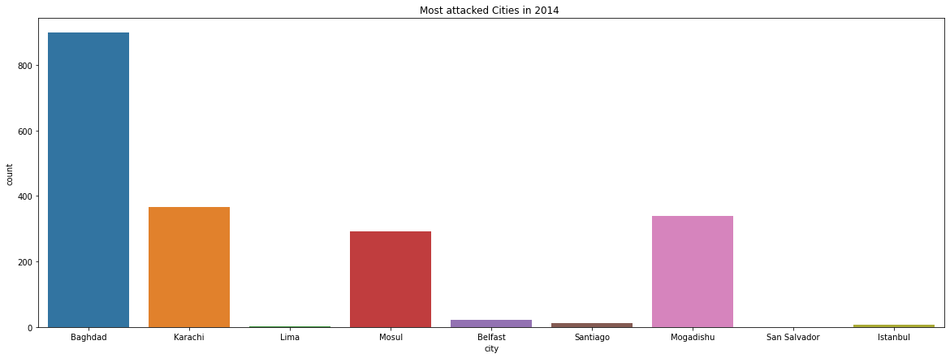
Comparison between attack_types and cities

Slide 25
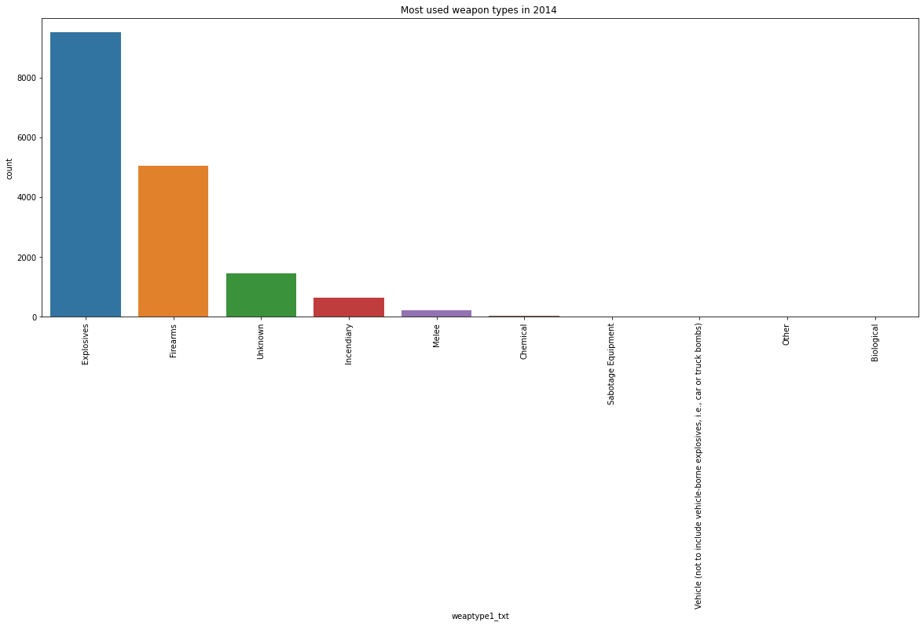
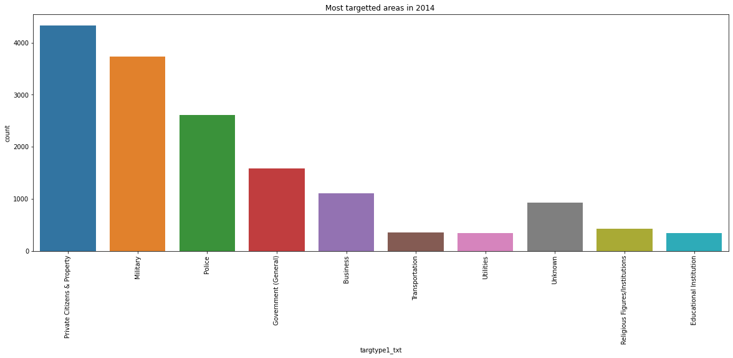
Charts displayed for comparison (most weapons used vs most targeted areas)

Slide 26
Final Insights
The Final Observations/Insights that we derive from the Global Terrorism Dataset using the Exploratory Data Analysis:
1. Attacks over years: The year 2014 had the most number of terrorist attacks i.e. 16903 attacks and the lowest number of attacks happened in the year 1971 i.e. 471 attacks.
2. Terrorist groups: Unknown group is the one which has done the most number of attacks 82728 with the Taliban in the 2nd place with 7478 attacks.
3. Countries attacked: Iraq has been the country with the most number of attacks i.e. 24636 and the least number of attacks held in 10 plus countries.
4. Region-wise killing and wounds: The Middle East and North Africa are the regions with the most kills (137642) and most wounds (214308).
5. Year-wise killing and wounds: 2014 has been the year with the most kills i.e. 44490 kills and 2015 has the most wounds occurred and remains at the top i.e. 44043 wounds.

Slide 27
Final Insights
6. Weapon types of terrorists: Explosives are the most frequently used weapon 92426 times and Radiological weapons are the least used i.e. 14 times.
7. Target types of terrorists: Private Citizens & Property are the most targeted i.e. 43511 times and another unknown target type is the least targeted 137 times.
8. Region-wise attacks: The most targeted region for terrorist attacks is the Middle East & North Africa with 50474 attacks (27.8%) and the least targeted region is Australasia & Oceania with 282 attacks (0.2%).
9. City-wise attacks: Baghdad is the most attacked city with 7589 attacks and Benghazi is the least attacked city with 840 attacks.
10. Attack types: The most frequently used attack type is Bombing/Explosion with 88255 times and the lowest used type is Hijacking with 659 times.

Slide 28
Final Insights
11. Suicides: 6633 suicides happened during the terrorist attacks.
12. Successful attacks: Total successful attacks are 161632 attacks and the attacks that went unsuccessful are 20059 attacks of the total attacks held.
13. The Year 2014 attacks (Most number of attacks):
(i). Country: number of attacks is 3933 in “Iraq”
(ii). Regions: number of attacks is 6939 in “The Middle East & North Africa”
(iii). Attack types: 8799 attacks by Bombing /Explosion is the most
(iv) Target types: 4331 attacks over Private Citizens & Property
(v) weapon type: 9521 Explosives are used
(vi) City: The most attacked city is Baghdad with 898 attacks.

Slide 29
Q & A

